Slide 1

Platformer game
This presentation made for Ala-too university

Slide 2
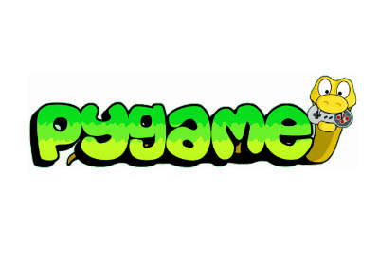
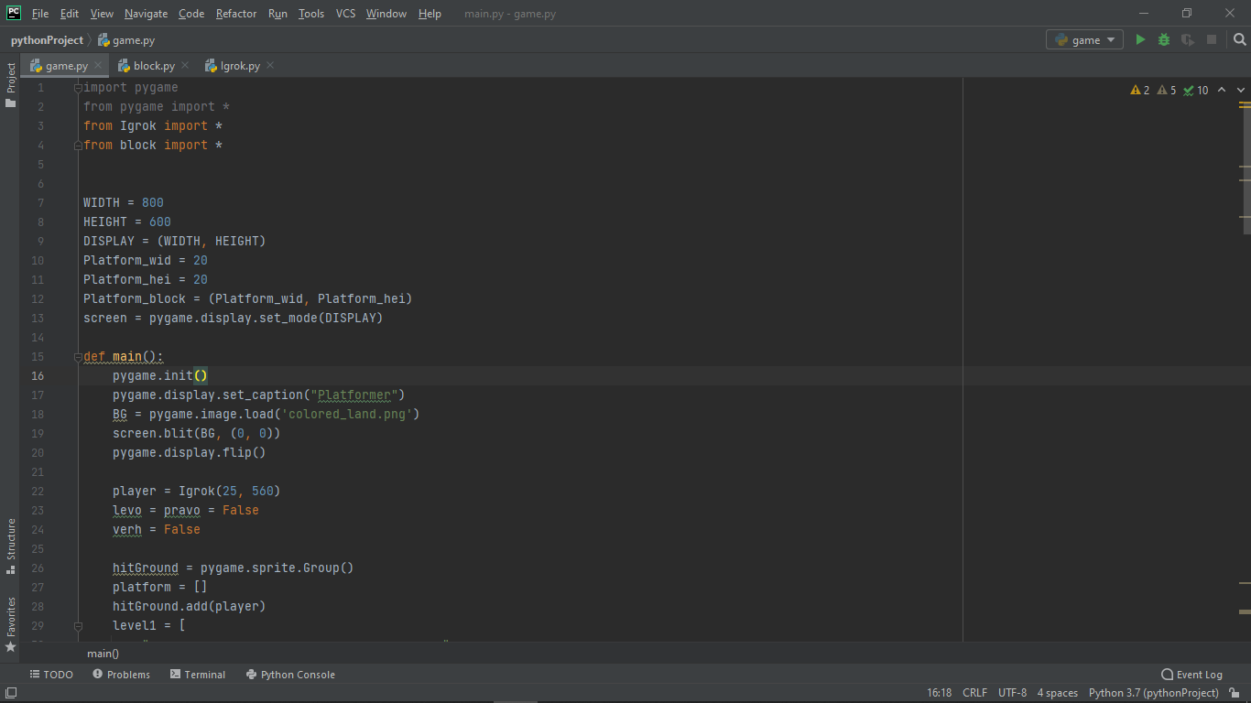
In our game we used pygame library

Slide 3
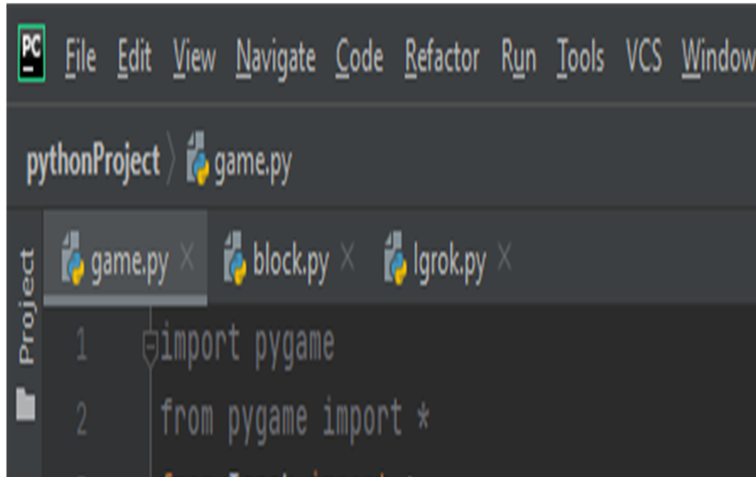
We used three python files for level, for player and for blocks in game

Slide 4
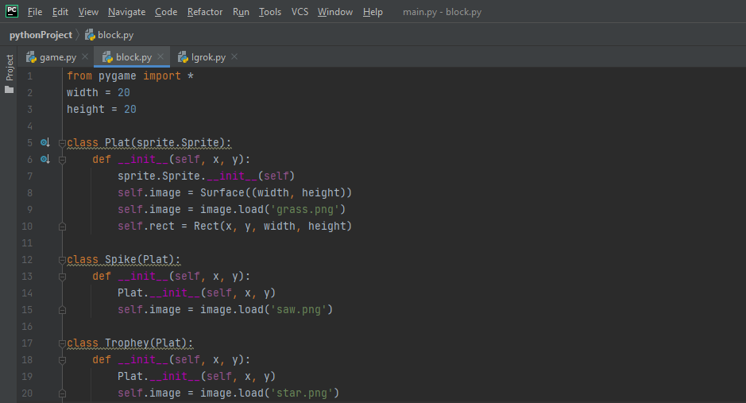
In this python file we write how blocks in game work. There are three kinds of blocks – platforms, spikes and trophey

Slide 5
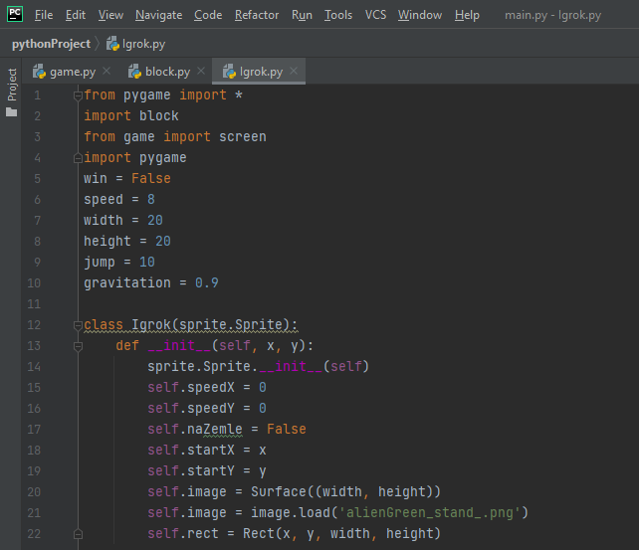
In this file we write player behavior like movement, jump, gravitation, reaction on blocks

Slide 6
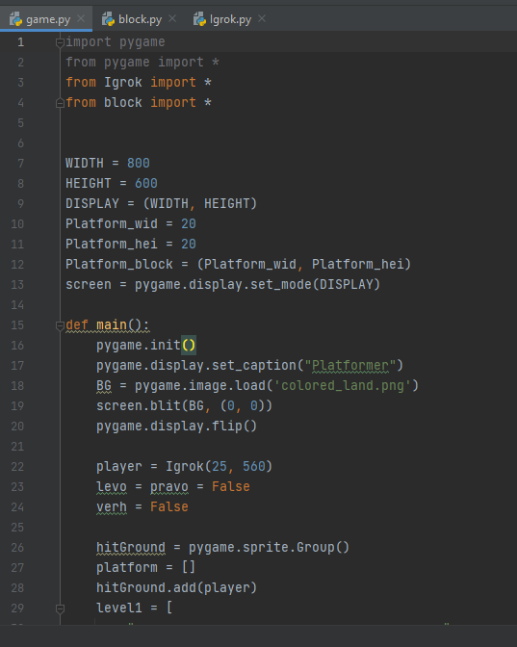
In file game we write basis of our game like display, level size, place where player start, location of spikes, blocks and trophey

Slide 7
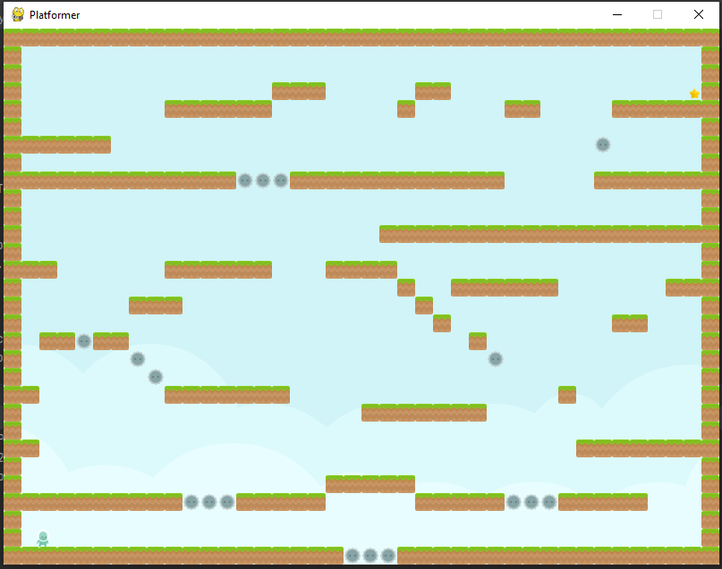
result

Slide 8
Presentation made by Tamerlan Rakhmanberdiev Nuriza paishan kyzy thanks for listening

